Slide 1
Vinho da ‘Ville
A Charlottesville Wine Story
Michael Kolonay - Jordan Machita - Stephen Morris - Siddharth Surapeneni

Slide 2
Agenda
Background
Executive Summary
Data Background
White Wines Analysis
Red Wines Analysis
Conclusion

Slide 3
Background - Vinho da ‘Ville
New winery planning to open next year in Charlottesville
Niche market for high quality Portuguese wine
Quality 7 or higher
Goals:
Understand and differentiate characteristics of Portuguese wine
Generate predictive model for best quality
Precision – distinguishing high quality wines
True Positive vs. False Positive

Slide 4
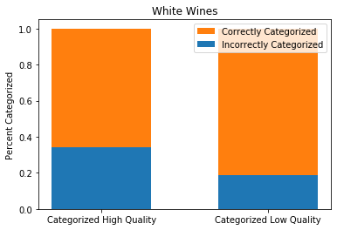
Executive Summary
White Wines
Alcohol Content (increase -> high quality)
Residual Sugars (increase -> high quality)
Chlorides (decrease -> high quality)
Density (decrease -> high quality)
White Wines
55% Threshold | Categorized as Low | Categorized as High
True Low Quality Wines | 1848 | 58
True High Quality Wines | 431 | 112
Note: Figures in green are categorized correctly; those in red are categorized incorrectly.

Slide 5
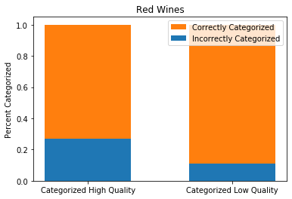
Executive Summary
Red Wines
Alcohol Content (increase -> high quality)
Sulphates (increase -> high quality)
Volatile Acidity (decrease -> high quality)
Red Wines
45% Threshold | Categorized as Low | Categorized as High
True Low Quality Wines | 676 | 11
True High Quality Wines | 83 | 30
Note: Figures in green are categorized correctly; those in red are categorized incorrectly.

Slide 6
Data Background
Source: UCI Machine Learning Repository
https://archive.ics.uci.edu/ml/datasets/wine+quality
1599 red, 4898 white wines
1 response variable: Quality
Categorical:
“High” = 7 or higher
“Low” = 6 or lower
11 predictor variables:
Alcohol
Residual Sugars
Density
Total Sulphur Dioxide
Free Sulphur Dioxide
Sulphates
Fixed Acidity
Volatile Acidity
Citric Acid
Chlorides
pH

Slide 7
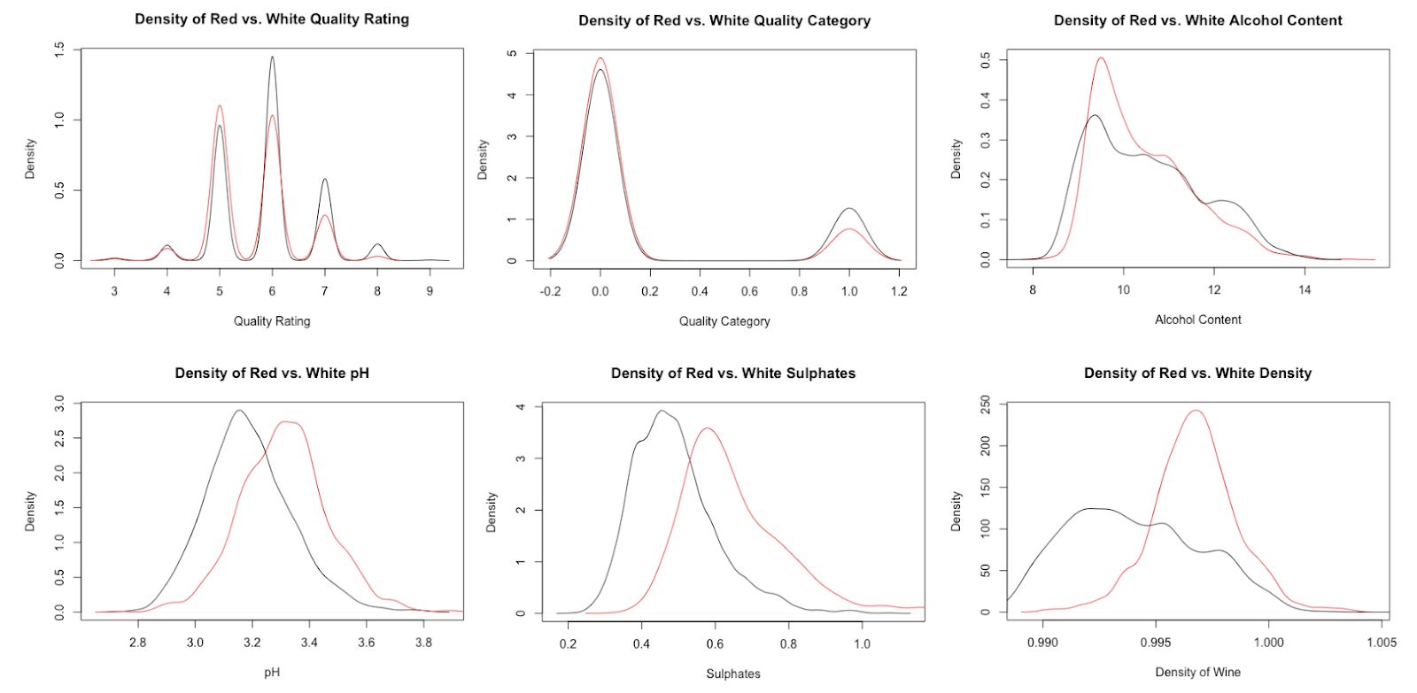
Data Background

Slide 8
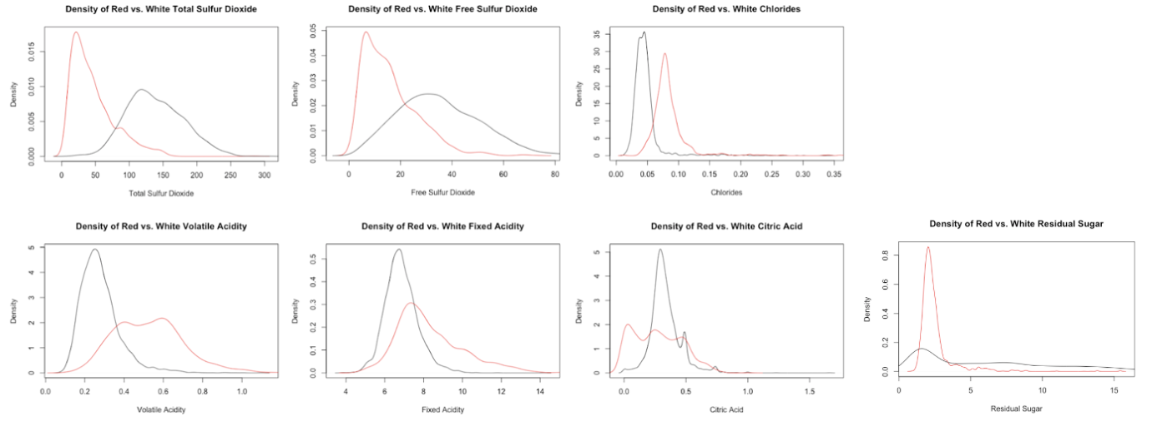
Data Background

Slide 9
Data Background

Slide 10
White Wines – Exploratory data Analysis
4898 wines:
1060 high quality
3838 low quality
Goal:
Predict high quality wines
Minimize false positives

Slide 11
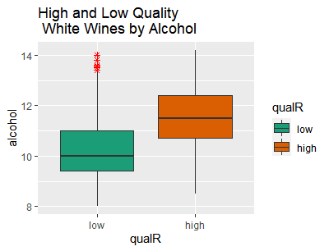
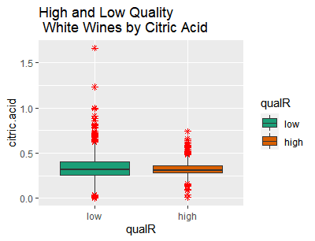
White Wines – Exploratory data Analysis
Boxplots of Alcohol and Citric Acid by Quality

Slide 12
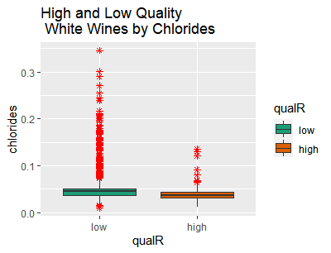
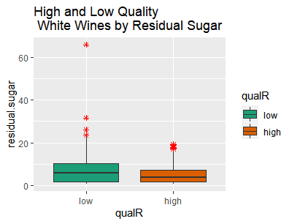
White Wines – Exploratory data Analysis
Boxplots of Chlorides and Residual Sugar by Quality

Slide 13
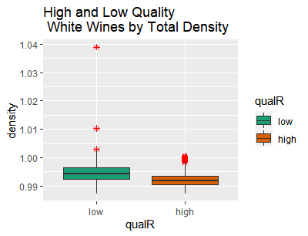
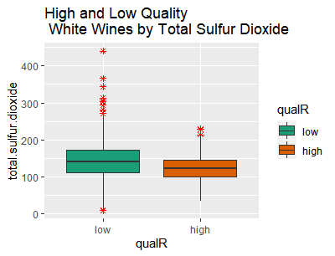
White Wines – Exploratory data Analysis
Boxplots of Density and Total Sulfur Dioxide by Quality

Slide 14
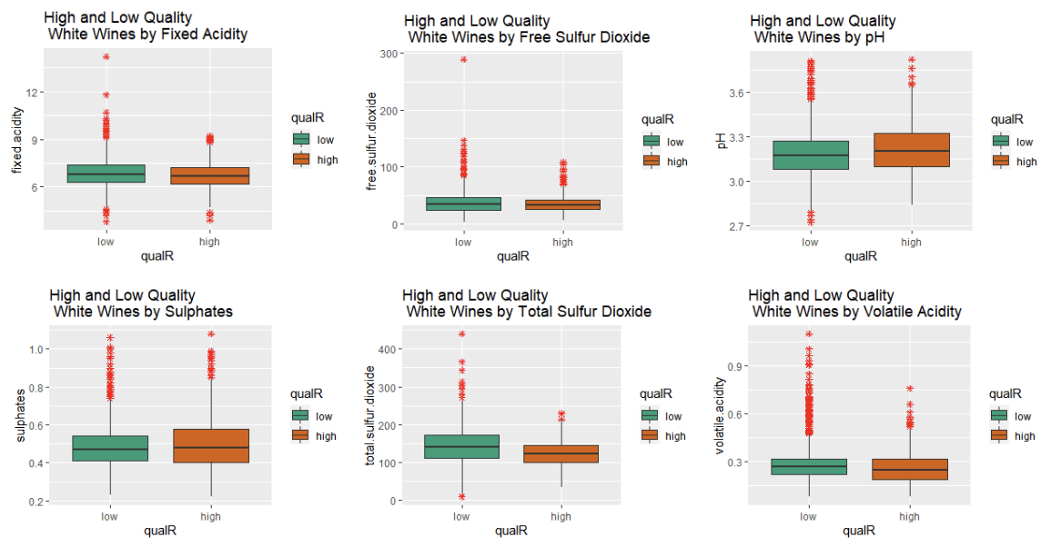
White Wines – Exploratory data Analysis
Boxplots of Remaining Predictors by Quality

Slide 15
Red Wines – Exploratory data Analysis
1599 wines:
113 high quality
687 low quality
Goal:
Predict high quality wines
Minimize false positives

Slide 16
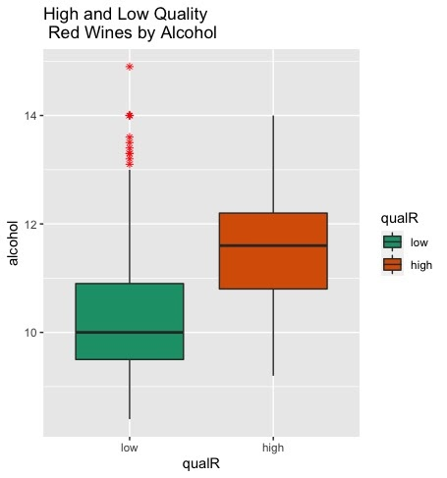
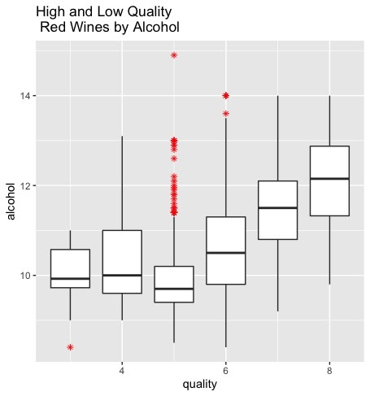
red Wines – Exploratory data Analysis
Boxplots of Alcohol by Quality

Slide 17
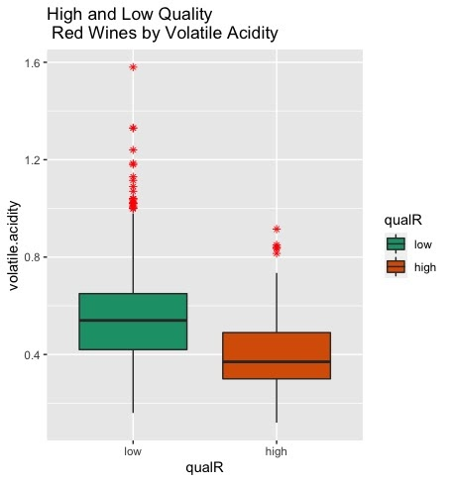
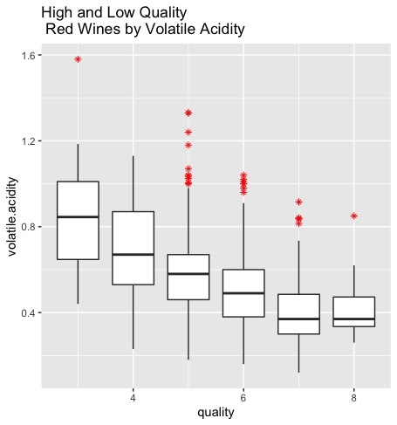
red Wines – Exploratory data Analysis
Boxplots of Volatile Acidity by Quality

Slide 18
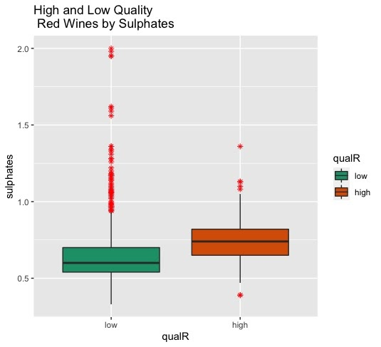
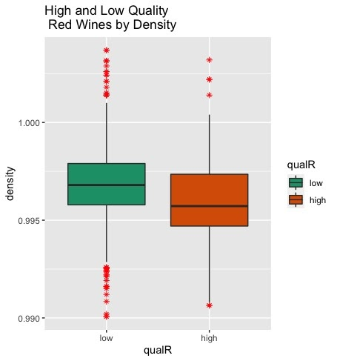
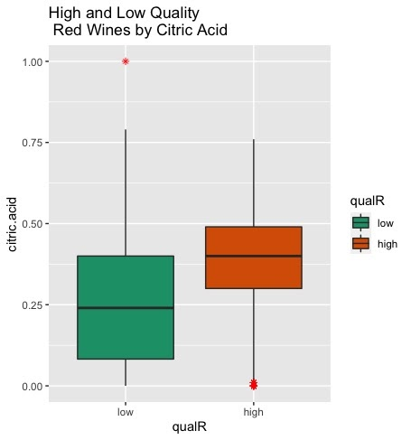
red Wines – Exploratory data Analysis
Boxplots of Sulphates, Density, and Citric Acid by Quality

Slide 19
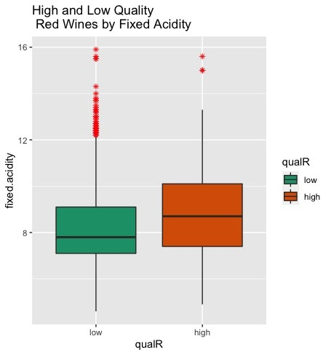
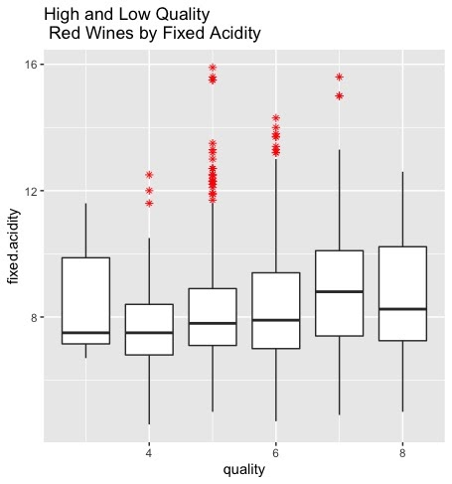
red Wines – Exploratory data Analysis
Boxplots of Fixed Acidity by Quality

Slide 20
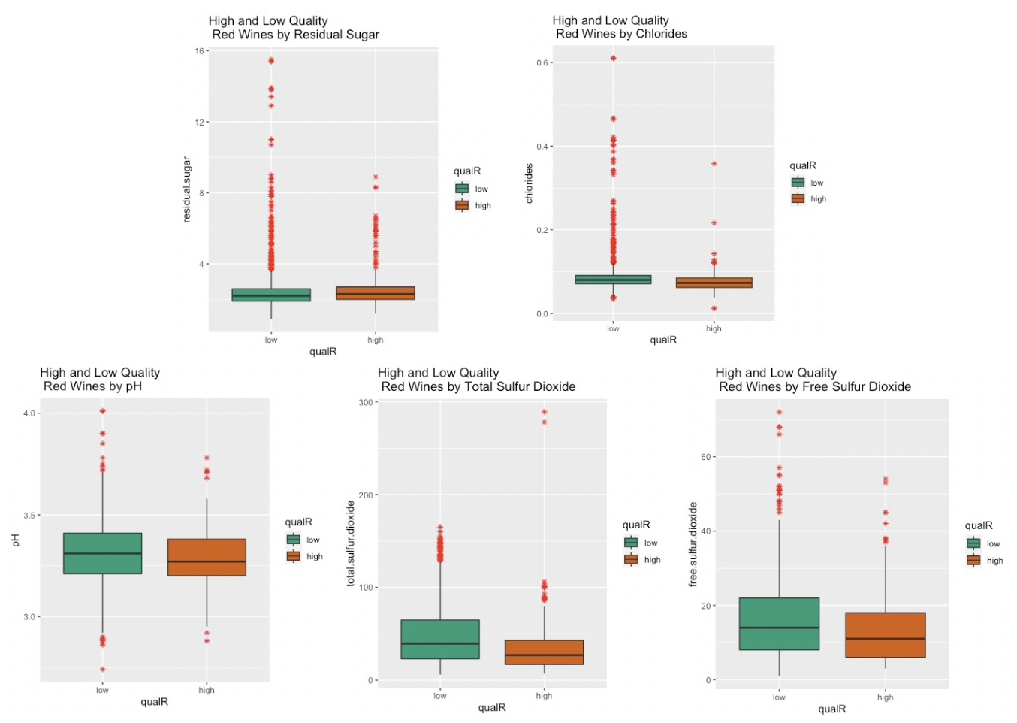
red Wines – Exploratory data Analysis
Boxplots of Remaining Predictors by Quality

Slide 21
Conclusion

